Slide 1
Bank loan of customers

Slide 2
Project Overview :
This presentation provides an overview of the project analyzing customer loan data from the Finance dataset. We will explore key performance indicators (KPIs) derived from two datasets, Finance 1 and Finance 2

Slide 3
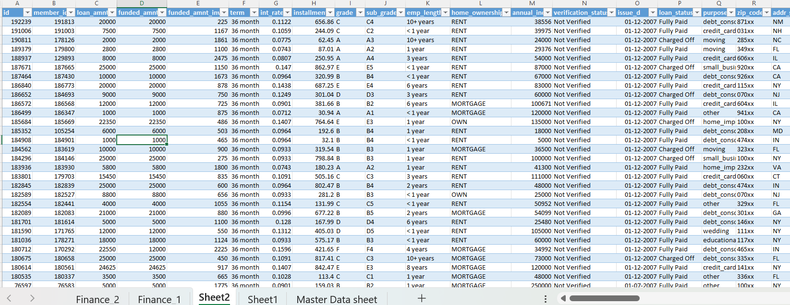
Dataset :Finance_1 & Finance_2

Slide 4

Key Performance Indicators (KPIs)
Year wise loan amount Stats
Grade and sub grade wise revol bal
Total Payment for Verified Status Vs Total Payment for Non Verified Status
State wise and month wise loan status
Home ownership Vs last payment date stats

Slide 5


Challenges
Handling date formats was a significant challenge during data processing, especially when transitioning data between Excel and SQL.
Understanding the Attributes in the Data (Domain Knowledge).

Slide 6


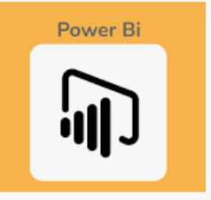

Used Platform :
Tableau
Excel
Power Bi
My SQL

Slide 7
1 . Year-wise Loan Amount Trends.
Insight: The loan amounts show consistent growth year over year, indicating an increase in borrowing trends.
Analysis: A spike in loan amounts was observed in certain years, possibly due to favorable economic conditions or changes in lending policies.
Recommendation: Analyze the factors that led to this increase to forecast future lending trends.

Slide 8
2 .Grade and Sub-Grade Wise Revolving Balance
Insight: Higher credit grades tend to have lower revolving balances, indicating better financial management by customers with higher credit scores.
Analysis: Customers in lower credit grades are more likely to have higher revolving balances, suggesting potential risk for lenders
Recommendation: Focus on managing and reducing revolving balances in lower credit grades through targeted financial advice or refinancing options.

Slide 9
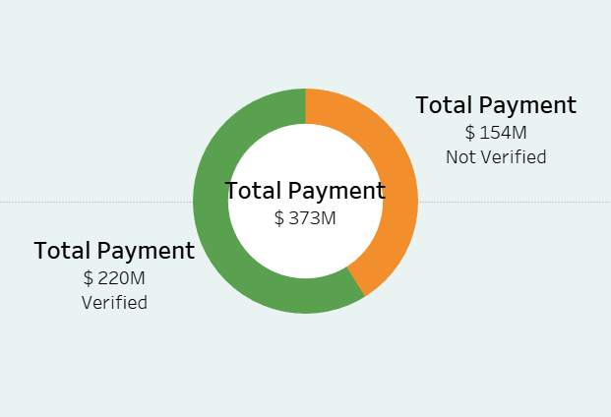
3 . Verified vs Non-Verified Status Total Payment
Insight: Verified customers have a higher total payment amount compared to non-verified customers.
Analysis: Verification status appears to correlate with more significant repayment behavior, which could be due to stricter lending criteria for verified loans.
Recommendation: Encourage customers to verify their status to improve loan performance and reduce default rates.

Slide 10
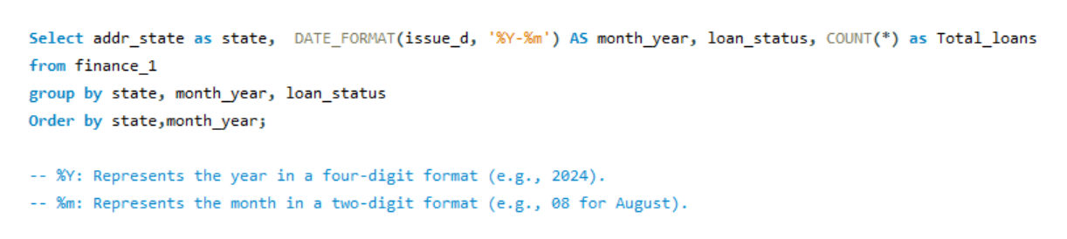
4 . State-wise and Month-wise Loan Status
Insight: Certain states show higher default rates, while others maintain healthier loan statuses.
Analysis: Loan performance varies significantly across states, which may be influenced by local economic conditions and employment rates.
Recommendation: Tailor lending strategies based on state-level performance and offer more flexible repayment options in higher-risk regions.

Slide 11
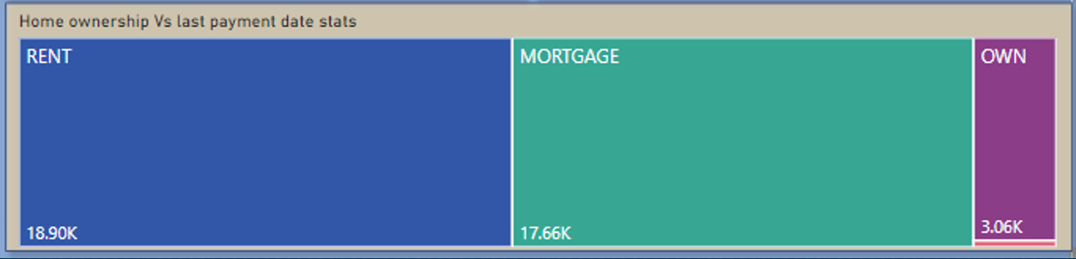
5. Home Ownership vs Last Payment Date
Insight: Homeowners tend to have more consistent and timely payments compared to non-homeowners
Analysis: Home ownership status could be a strong indicator of financial stability, which influences payment behavior.
Recommendation: Consider offering special incentives or better rates to homeowners, as they demonstrate lower risk.

Slide 12
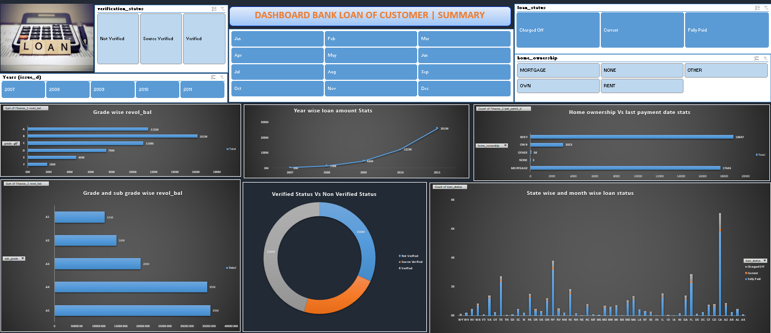
Dashboard : Excel

Slide 13
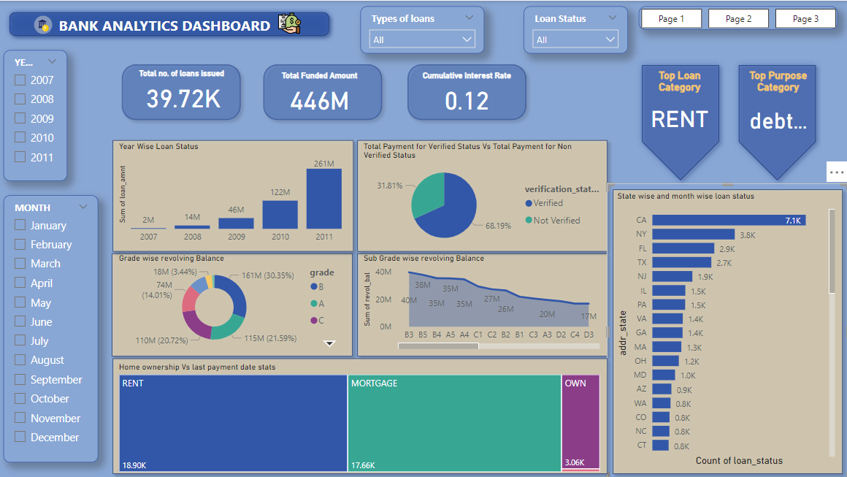
Dashboard : Power Bi

Slide 14
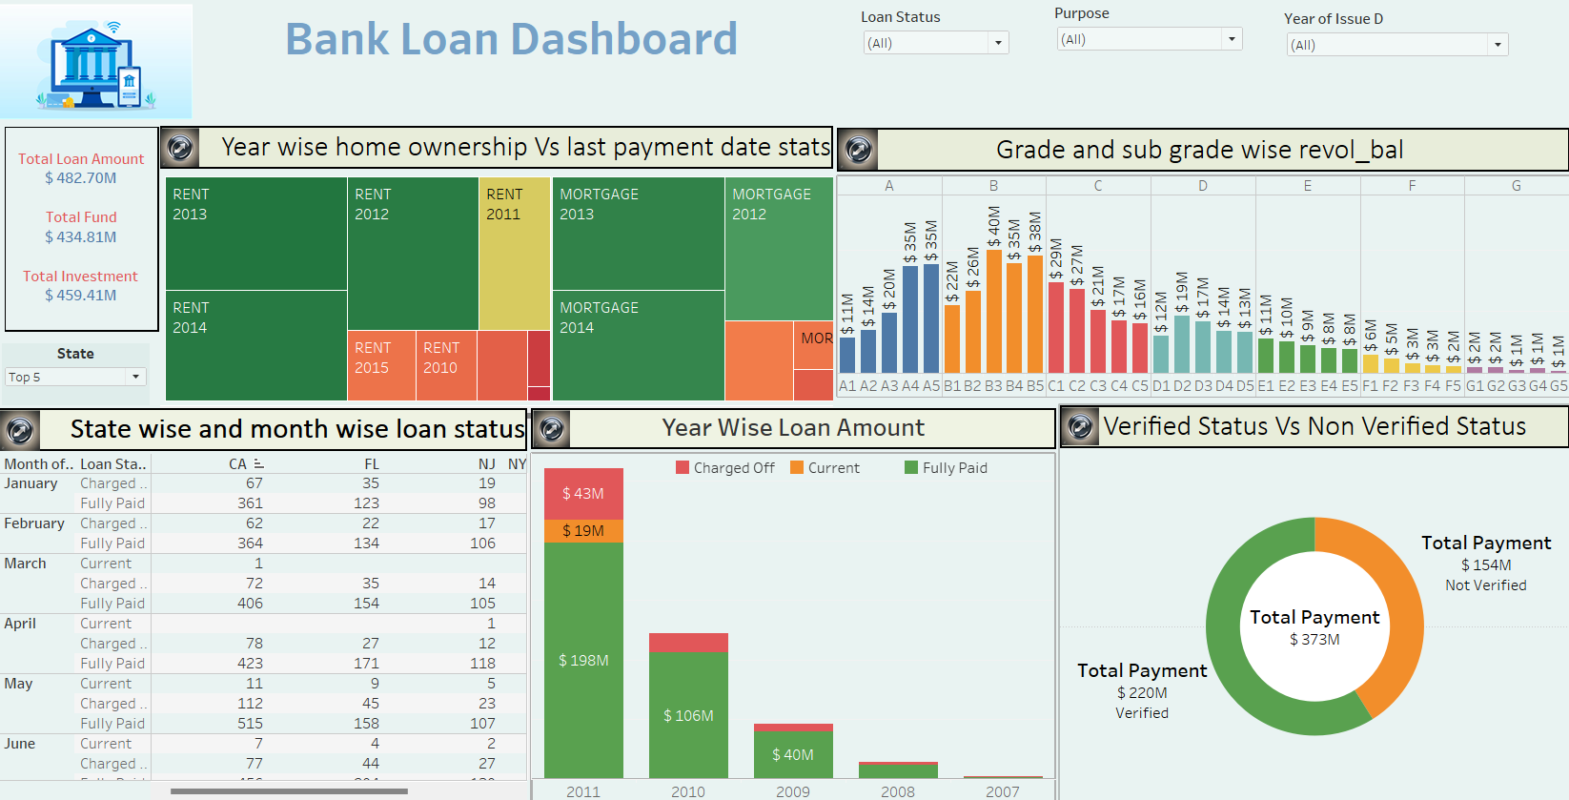
Dashboard : Tableau

Slide 15
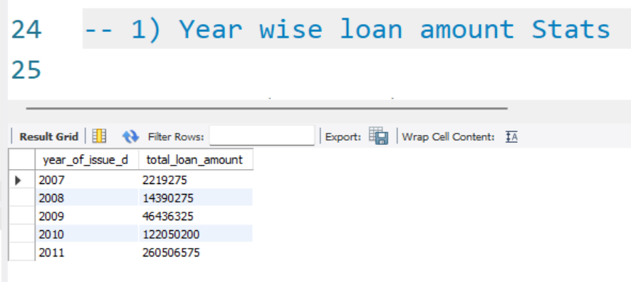
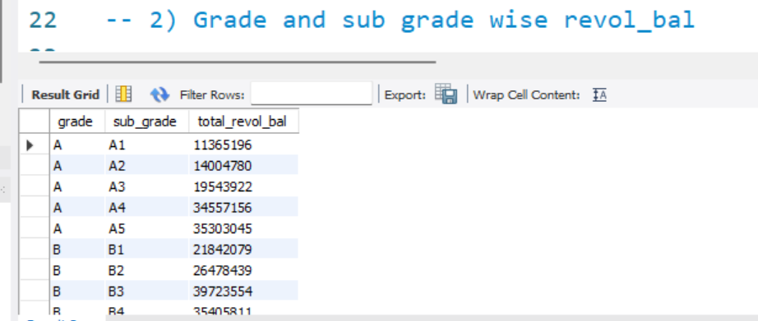
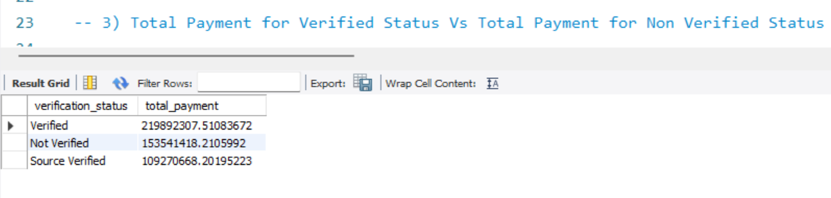
Dashboard : SQL

Slide 16
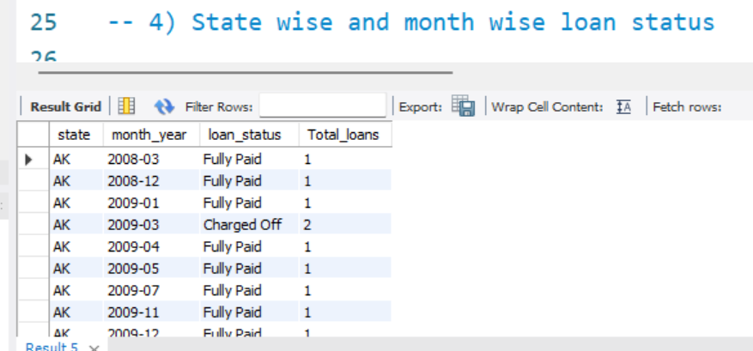
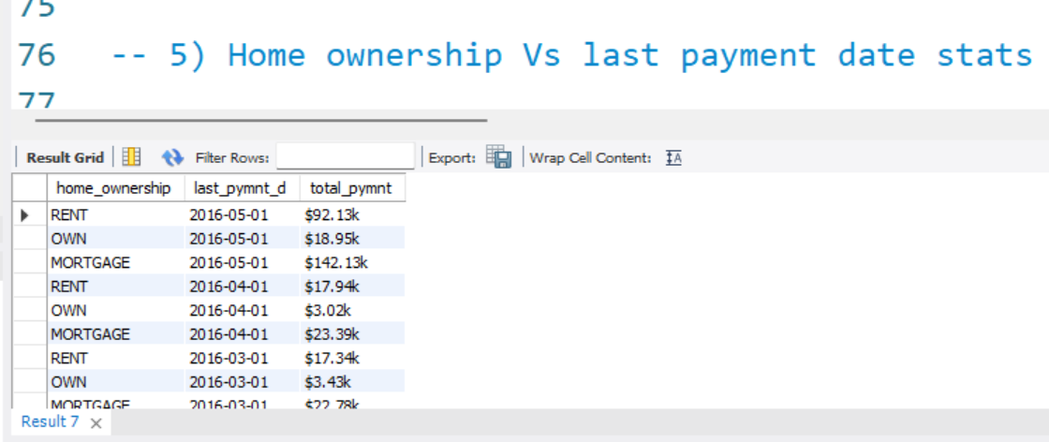
Dashboard : SQL

Slide 17
Thank You

